Slide 1
Quality Educational Assessment: The spicing of Educational Reformation by Chiwiye Timothy (Dr) tchiwiye@yahoo.com +263 773 613 548 13th SAAEA Conference hosted by Botswana Examinations (BEC) Council on 20-22 May 2019

Slide 2
Presentation Outline
The topology of educational reform (from players to outcomes)
Schools of thought about education in general
Schools of thought about quality and inclusive assessment and the direction we may take

Slide 3
Introduction
The presenter views educational reform as:
a political and complex endeavour.
there are those who take a conservative ideological stance against reforms and resist any form of innovation and change
These are driven by a fear factor and cannot concede to move even an inch.
Such a constituent has created pseudo-empires around the ideology and any paradigm shift is perceived a serious threat to the status quo

Slide 4
…… Introduction
At the other extreme of the continuum:
Are those who are obsessed with radical change devoid of context
Whose reforms are not grounded on socioeconomic dynamics of the country
Whose reform is change for the sake of change, which when subjected to critical analysis, it falls short from providing solutions to consumers’ problems.

Slide 5
…… Introduction
On this continuum, this scholar subscribes to a:
needs driven reform which precedes a sound feasibility study of the national vision and agenda
reform that offers equal opportunities for ALL learners and gives hope to communities at large
reform that is anchored on meaningfulness and authenticity, pursuing new innovative ideas, mounting assessment frameworks on home grown ICT platforms to contain runaway costs to achieve cost effectiveness.

Slide 6
critical questions that come to the fore
Who are the players or agents of educational reformation?
What are the drivers (motivators) of educational reformation?
What is the process of reformation like?
What informs the timing?
What are the anticipated outcomes (product) of this reformation?
Do players (agents) consume the product out of their initiated reform?

Slide 7
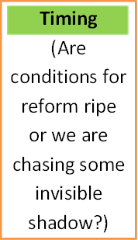
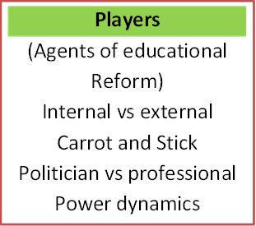
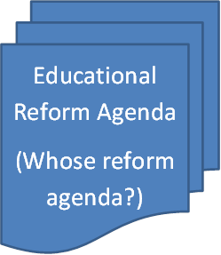
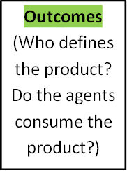
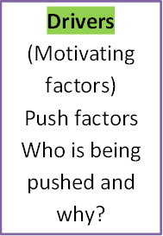
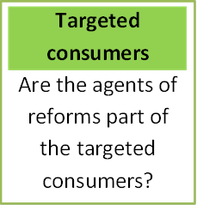

Slide 8
Educational Assessment in an Era of reform
Behaviourism - Cognitivism
these treat learners as a black box, where inputs into the black box are known and measurable, but what goes on inside the black box is ignored or not considered of interest
On the contrary , learners have the ability for conscious thought, decision-making, emotions, and the ability to express ideas through social discourse, all of which are highly significant for learning and must be assessed.

Slide 9
Educational Assessment in an Era of reform
Constructivism emphasises
the importance of consciousness, free will and social influences on learning.
every individual exists in a continually changing world of experience in which he is the center.
The external world is interpreted within the context of that private world. Humans are essentially active, free and strive for world meaning in personal terms.

Slide 10
Educational Assessment in an Era of reform
I believe that knowledge is essentially subjective in nature, constructed from our perceptions and mutually agreed upon conventions
A Social Constructivists believe that this process works best through discussion and social interaction, allowing us to test and challenge our own understandings with those of others
physical laws exist because they have been constructed by people from evidence, observation, and deductive or intuitive thinking, etc.
Educational assessment verifies what constitutes valid knowledge. How?
Assessment - assidēre (to sit down, Sit by, camp near). Assessment is conceptualised not as a remote endeavour

Slide 11
Quality Assessment thought
nations seized with education reforms, must be quick to infuse in the process the art and science of functional assessment to glamour these reforms.
cultural validity in assessment is a critical issue in determining the accuracy of the results and its implications on mastery and instructional practices, Basterra (2011).
tests using a single measurement field with complex language results in learners give answers which do not accurately reflect their content knowledge.
Multiple assessment measurement can provide valid information about the candidate, (Basterra, 2011, and Gottlieb, 2006).

Slide 12
Quality Assessment Thought
Quality assessment procedures and systems must focus on equity concerns to ensure that all candidates are well served
Assessment systems have attracted criticisms for their perceived imperfections in measuring achievement. Bias, unfairness and inequities etc are enemies of quality educational assessment
Increasing diversity of societies among other factors has increased the need to offer equal opportunities
Many of the measures most widely used have established validity and reliability, in some instances, these measures are often used inappropriately and unethically with populations from diverse background, (Kofitse, 2010, Sedlacek and Kim (1995).

Slide 13
Educational assessment thought
It is important that the measure be the best it can possibly be and that the diversity of the population must be recognized in developing and/or selecting that measure so that equity and access are maximized, Popham (2002)
Diversity validity is critical for accurate assessment.
Assessment is creating unjustifiable classes on the economic scale instead of equalising opportunities.

Slide 14
Educational assessment thought
Consider
reliability vs validity
Formative vs summative
Uniform models of tests vs individual styles and cultural background
The dilemma
Laudable educational objectives like understating, appreciation, critical thinking, creativity, etc are difficult to measure
Rote learning – easy to assess – has little educational validity
Shall we teach only what we cam measure then?
If YES , limit curricular to fairly low level objectives- disregard higher order
If NO, all that is taught will not be assessed

